Slide 1
Data Structure and Algorithms-I
Arrays: Memory Mapping, Linear and Binary Search, Linear Time
Sorting (Counting Sort)
Lecturer Saifur Rahman, Dept. of CSE, United International University

Slide 2

Arrays
An array is an indexed sequence of components
The components of an array are all of the same type
Typically, the array occupies sequential storage locations
Array is a static data structure, that is, the length of the array is determined when the array is created, and cannot be changed
Each component of the array has a fixed, unique index
Indices range from a lower bound to an upper bound
Any component of the array can be inspected or updated by using its index
This is an efficient operation: O(1) = constant time
Lecturer Saifur Rahman, Dept. of CSE, United International University

Slide 3
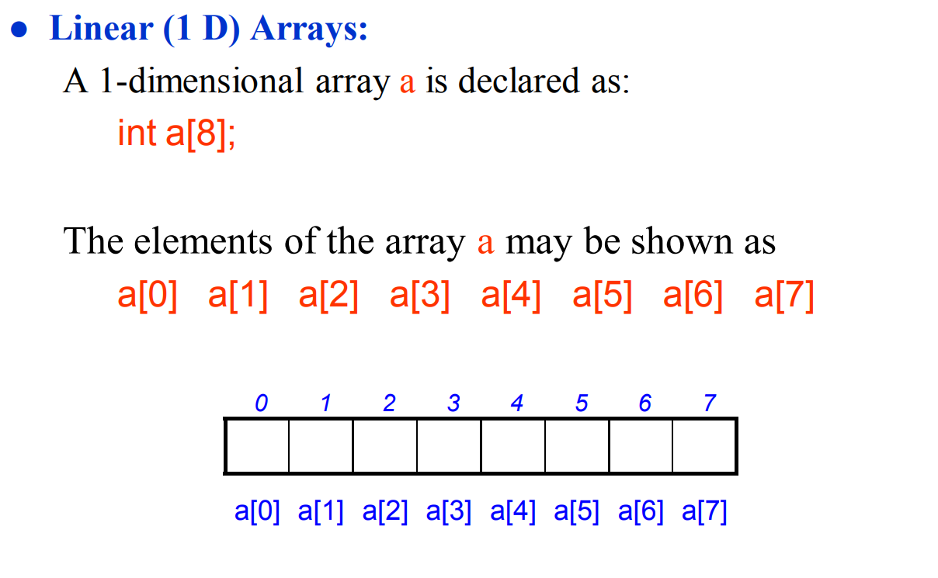
Representation of Arrays in Memory
Lecturer Saifur Rahman, Dept. of CSE, United International University

Slide 4
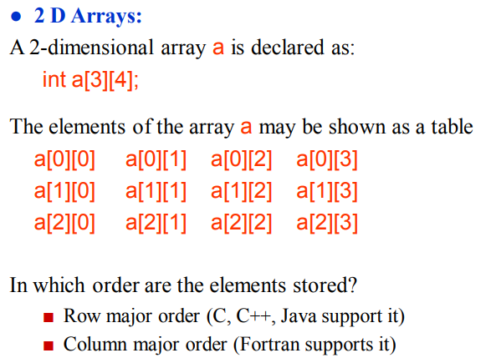
Representation of Arrays in Memory
Lecturer Saifur Rahman, Dept. of CSE, United International University

Slide 5
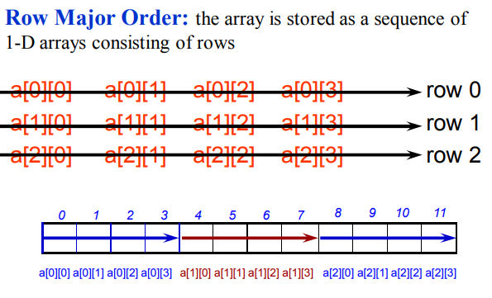
Representation of Arrays in Memory
Lecturer Saifur Rahman, Dept. of CSE, United International University

Slide 6
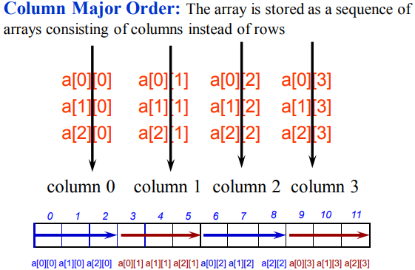
Representation of Arrays in Memory
Lecturer Saifur Rahman, Dept. of CSE, United International University

Slide 7
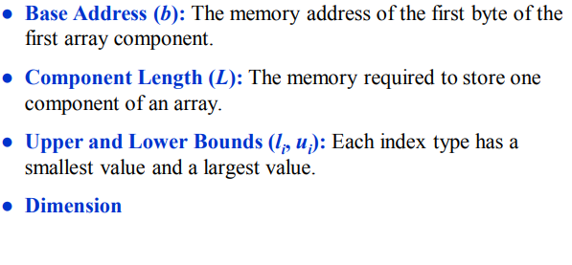
Representation of Arrays in Memory: Parameters
Lecturer Saifur Rahman, Dept. of CSE, United International University

Slide 8
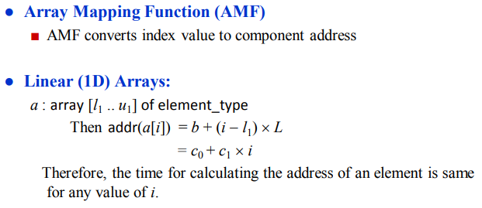
Representation of Arrays in Memory
Lecturer Saifur Rahman, Dept. of CSE, United International University

Slide 9
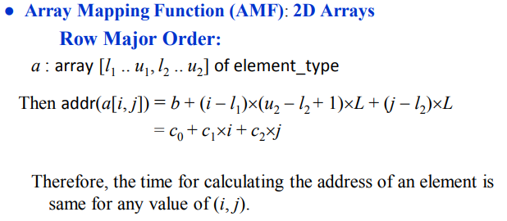
Representation of Arrays in Memory
Lecturer Saifur Rahman, Dept. of CSE, United International University

Slide 10
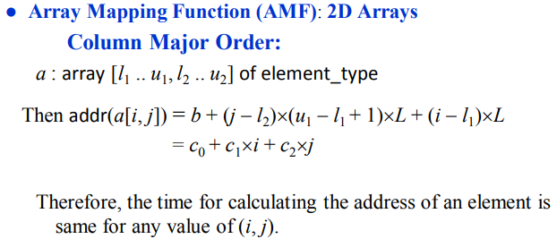
Representation of Arrays in Memory
Lecturer Saifur Rahman, Dept. of CSE, United International University

Slide 11
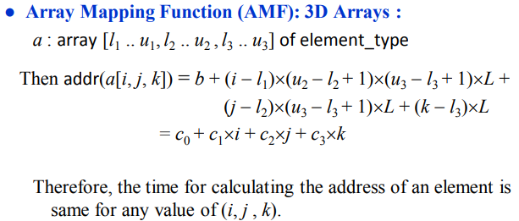
Representation of Arrays in Memory
Lecturer Saifur Rahman, Dept. of CSE, United International University

Slide 12
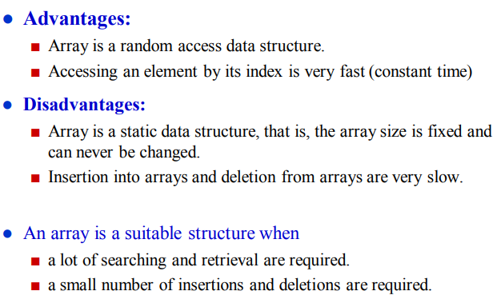
Summary on Arrays
Lecturer Saifur Rahman, Dept. of CSE, United International University

Slide 13
Searching Algorithms:
Linear Search, Binary Search
Lecturer Saifur Rahman, Dept. of CSE, United International University

Slide 14
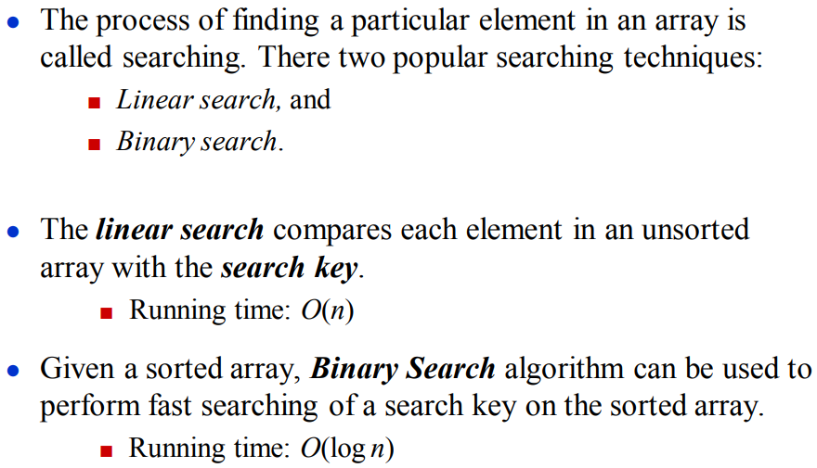
The Searching Problem
Lecturer Saifur Rahman, Dept. of CSE, United International University

Slide 15
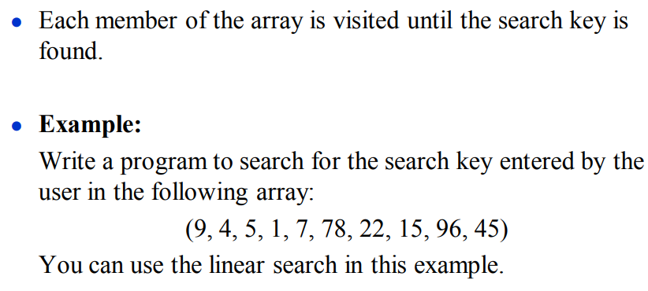
Linear Search
Lecturer Saifur Rahman, Dept. of CSE, United International University

Slide 16
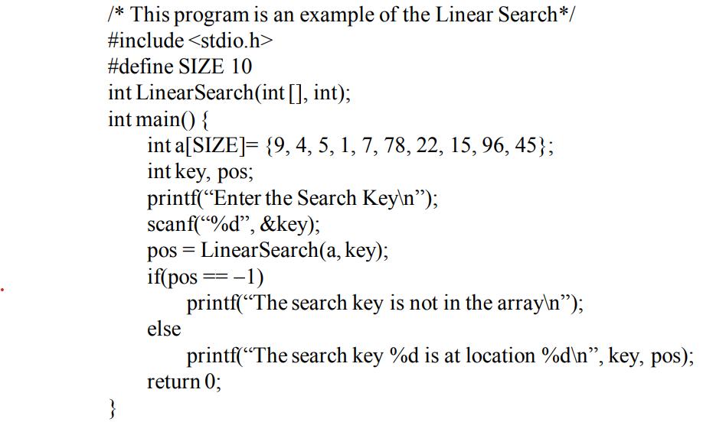
Linear Search
Lecturer Saifur Rahman, Dept. of CSE, United International University

Slide 17
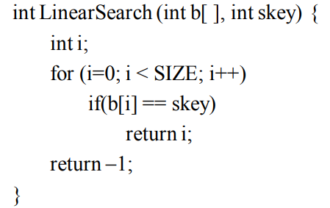
Linear Search
Lecturer Saifur Rahman, Dept. of CSE, United International University

Slide 18
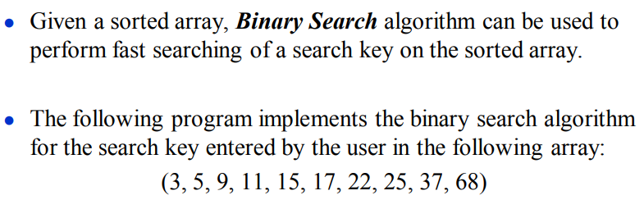
Binary Search
Lecturer Saifur Rahman, Dept. of CSE, United International University

Slide 19
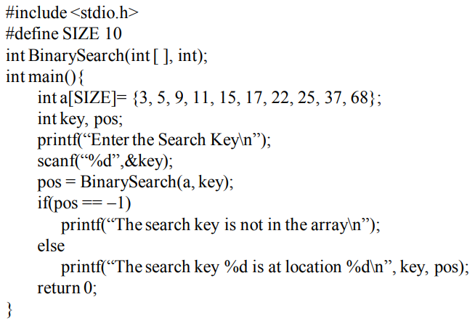
Binary Search
Lecturer Saifur Rahman, Dept. of CSE, United International University

Slide 20
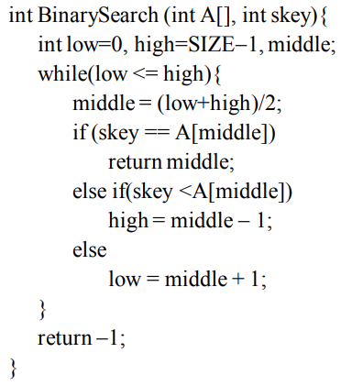
Binary Search
Lecturer Saifur Rahman, Dept. of CSE, United International University

Slide 21
Linear-Time Sorting Algorithm:
Counting Sort
Lecturer Saifur Rahman, Dept. of CSE, United International University

Slide 22
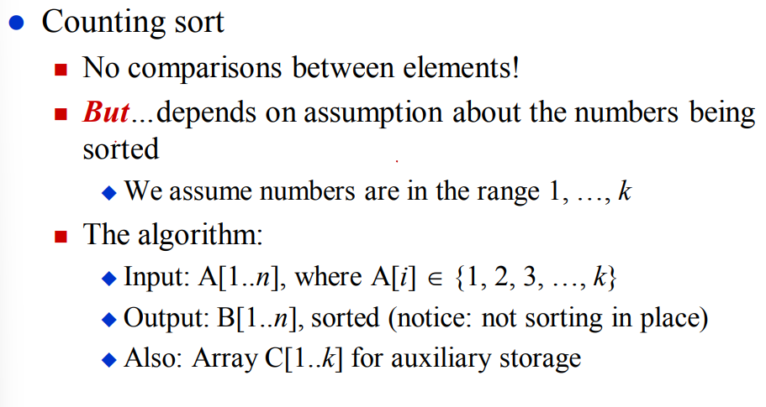
Sorting in Linear Time
Lecturer Saifur Rahman, Dept. of CSE, United International University

Slide 23
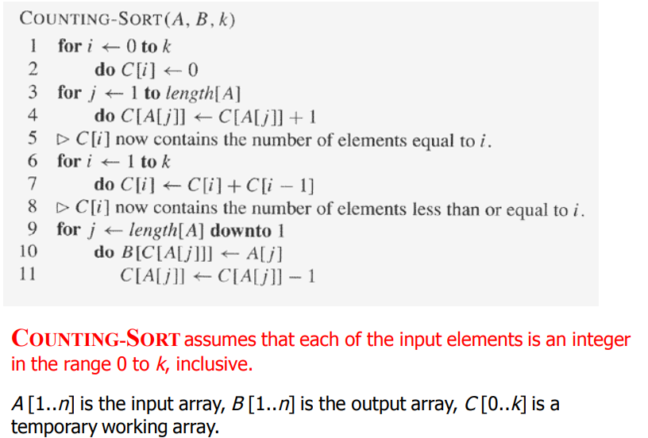
Counting Sort
Lecturer Saifur Rahman, Dept. of CSE, United International University

Slide 24
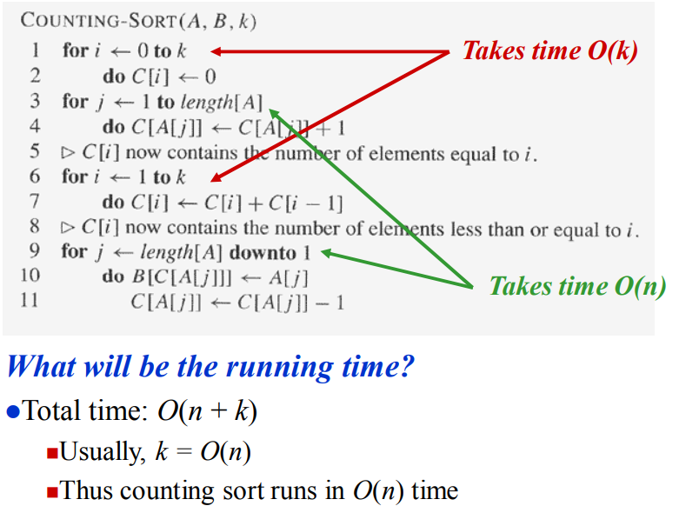
Counting Sort
Lecturer Saifur Rahman, Dept. of CSE, United International University

Slide 25
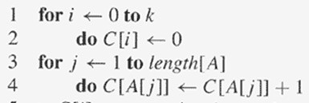
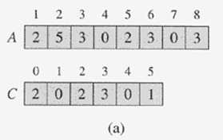
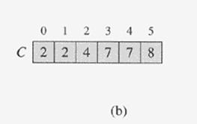

Counting Sort
Lecturer Saifur Rahman, Dept. of CSE, United International University

Slide 26
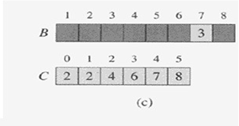
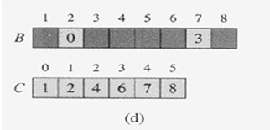

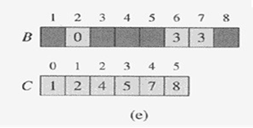
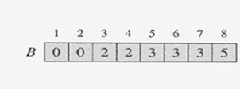
Counting Sort
Initial
1st Iteration
2nd Iteration
3rd Iteration
Final Result
Lecturer Saifur Rahman, Dept. of CSE, United International University

Slide 27
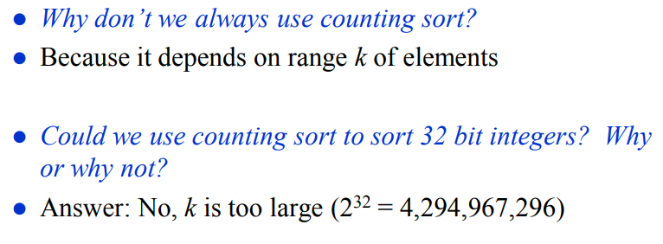
Counting Sort
Lecturer Saifur Rahman, Dept. of CSE, United International University

